Slide 1



HEALTH DIET CONSULTATION SYSTEM
By
Narra Manas (2110030085)
Gurram Karyacharan (2110030106)
Nara Badrinath (2110030163)
K Amith (2110030372)
Under the guidance of
(Dr. Sheikh Fahad Ahmad)

Slide 2
INTRODUCTION
Our Project name is Online Health Diet Consultation System which is a Web Application that helps users to be healthy in their busy schedules.
It will take the details of the user such as height, weight, and age and it will take the health information of the user such that if the user has any health issues then it will give some tips on diet to them or else if no health issues it will give tips according to their height, weight, and age.
It will also allow the user to book consultation sessions and it will also show the best dietician details.

Slide 3
PROBLEM STATEMENT AND DOMAIN
When a person wants to maintain any diet, some people do not know what precautions and how to maintain a diet.
Without taking perfect precautions the diet may crash then it may cause so many side effects to the body and health of the person, it can reduce your metabolic rate and also it can weaken your immune system, and like that so many side effects may affect the person.
Nowadays due to illness or any injuries, so many people are consulting doctors to take the advice of doctors like precautions to take in diet. This may waste a lot of time as well as money for a person.
When we are far from our place, we can’t consult our doctor.
So in these cases, people can use our app.

Slide 4
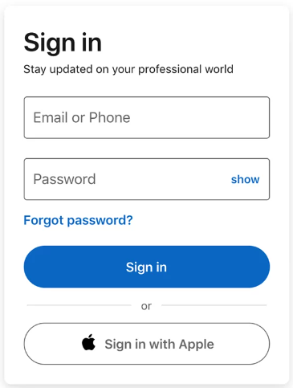
STEPS TO BE FOLLOWED BY USER
STEP-1: Login Window.

Slide 5
STEP-2: It takes the details of the user such as:-
Height, Weight, Age, etc.
CALORIE COUNTER – The user can enter the food he ate, and according to that it will count the calories of the user.
CONSULTATION PAGE – This helps the user to consult the best doctors or dieticians.
DIET PLANS – This helps the user to plan the diet of the user according to their health and schedule.
HEALTHY ESSENTIALS – This suggests the user use certain products which help the user to maintain stable health and diet.

Slide 6
EXISTING SOLUTIONS/ NAÏVE SOLUTIONS
There are some existing solutions for health diet consultation systems such as:-
MyPlate Calorie Counter
PlateJoy
MyFitnessPal
Yummly Recipes & Cooking Tools
Lifesum: Healthy Eating
Ate Food Journal.

Slide 7
RESEARCH PAPERS
https://scholarworks.lib.csusb.edu/cgi/viewcontent.cgi?article=2050&context=etd
http://apps.who.int/iris/bitstream/handle/10665/42665/WHO_TRS_916.pdf;jsessionid=554E6EEE7AEF347062E6091A804087BD?sequence=1

Slide 8
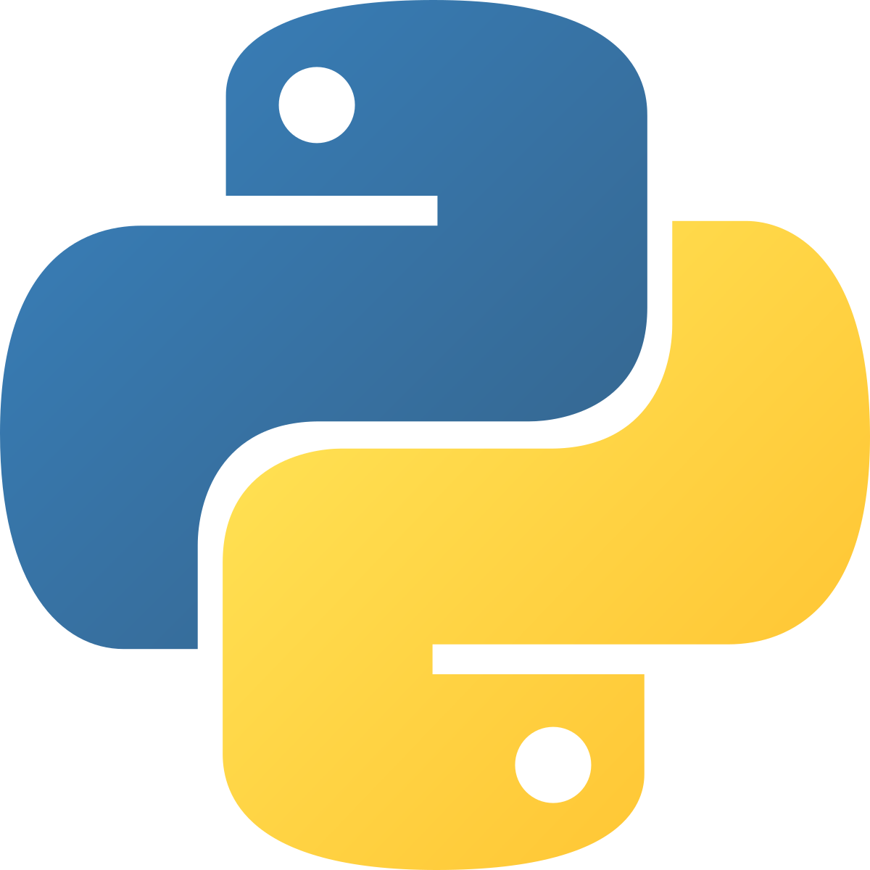
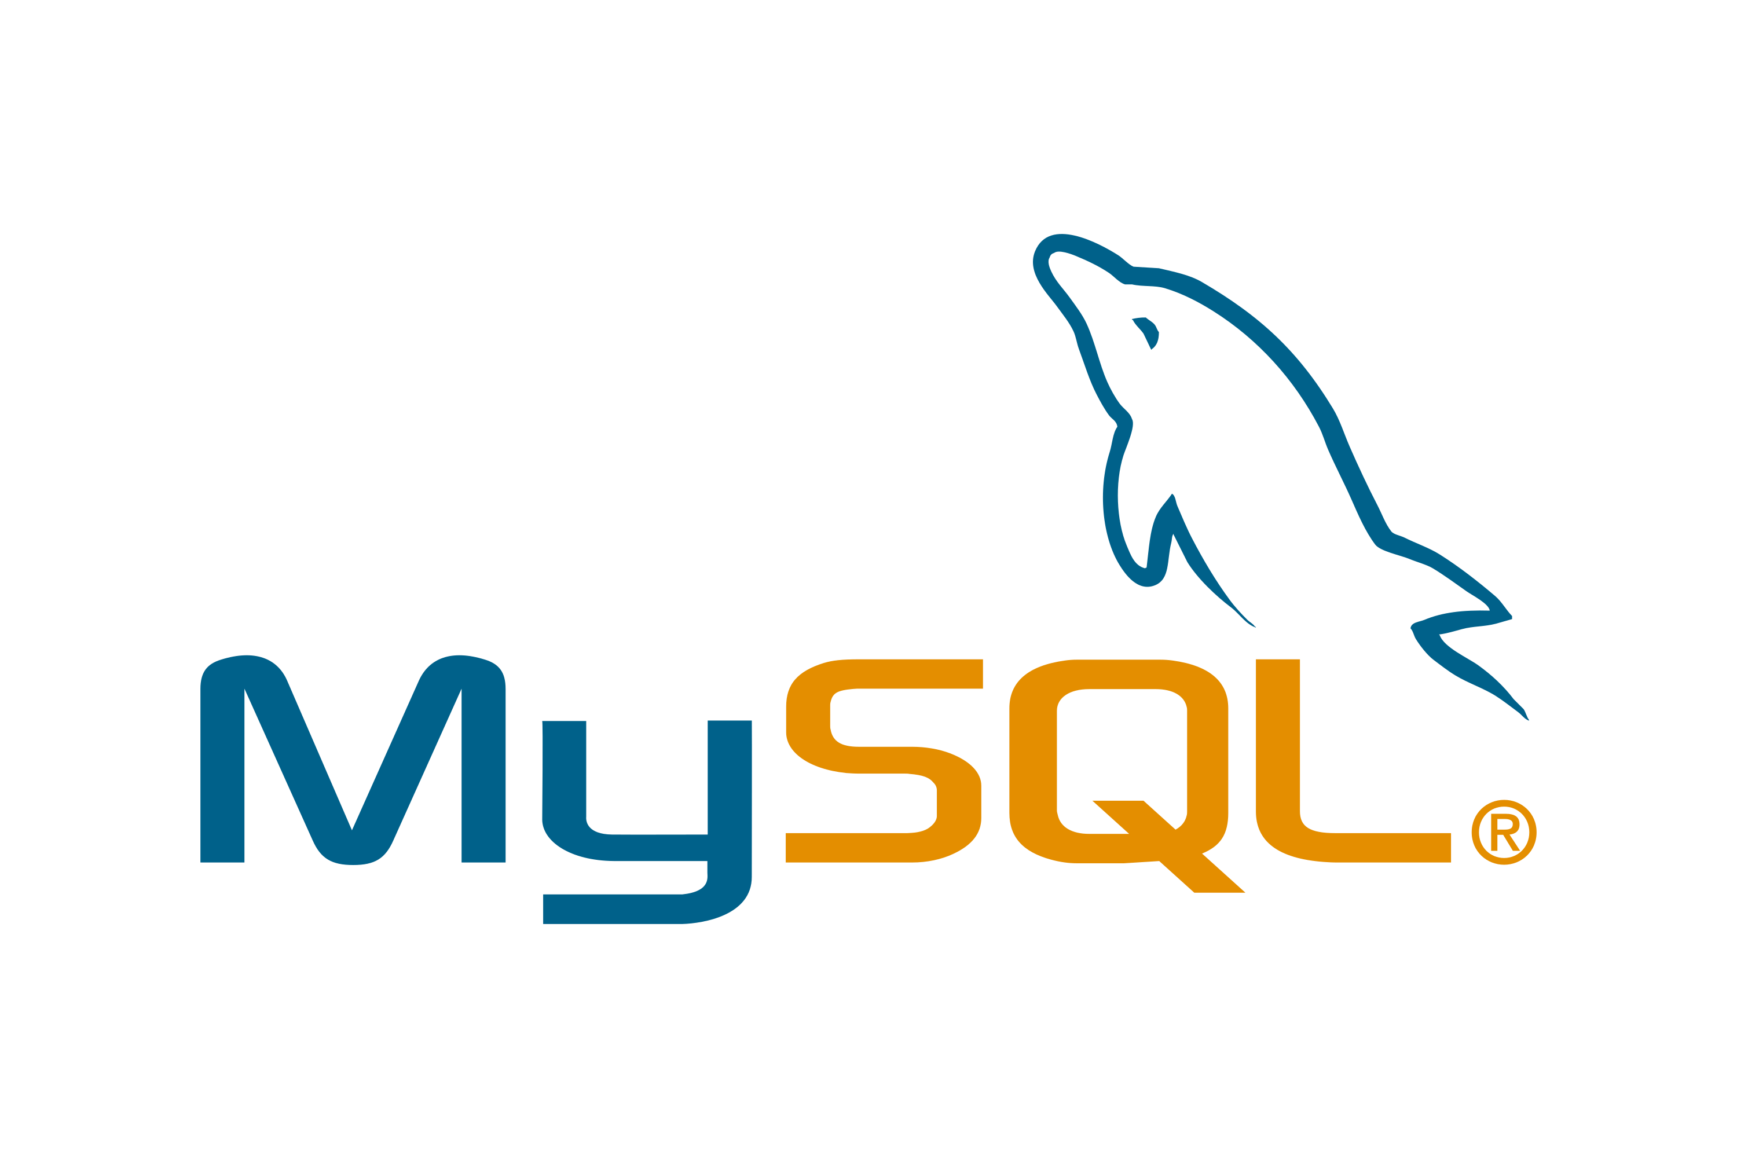


PROJECT REQUIREMENTS
Python
MySql
Visual Studio Code
STARUML
TerraER

Slide 9
PROPOSED ALGORITHM DESIGN TECHNIQUE
We use the waterfall model in our project
The waterfall Model illustrates the software development process in a linear sequential flow. This means that any phase in the development process begins only if the previous phase is complete.
In this waterfall model, the phases of communication, planning, modeling, construction, and deployment do not overlap.

Slide 10
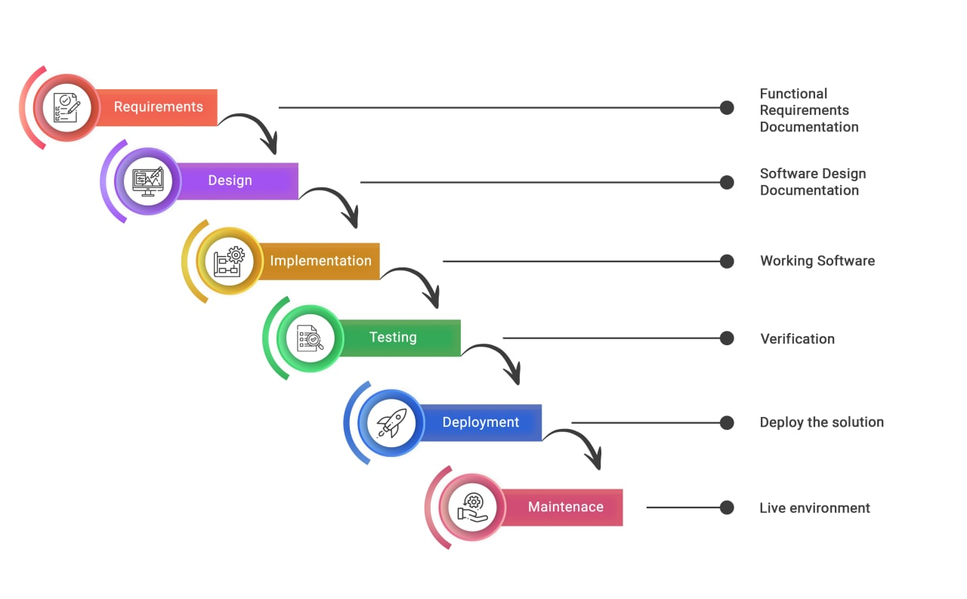
WATERFALL MODEL

Slide 11
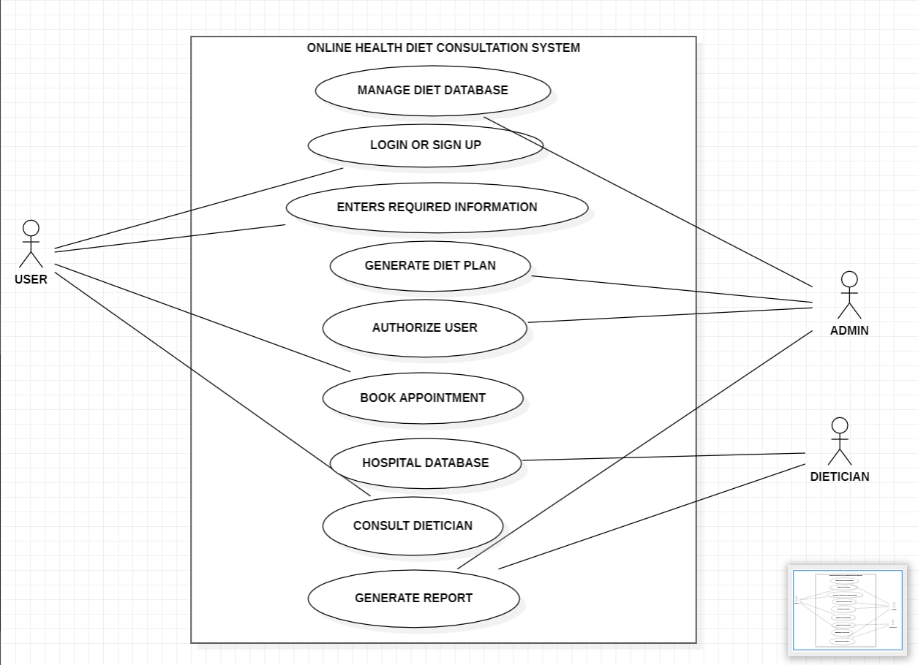
USE CASE DIAGRAM

Slide 12
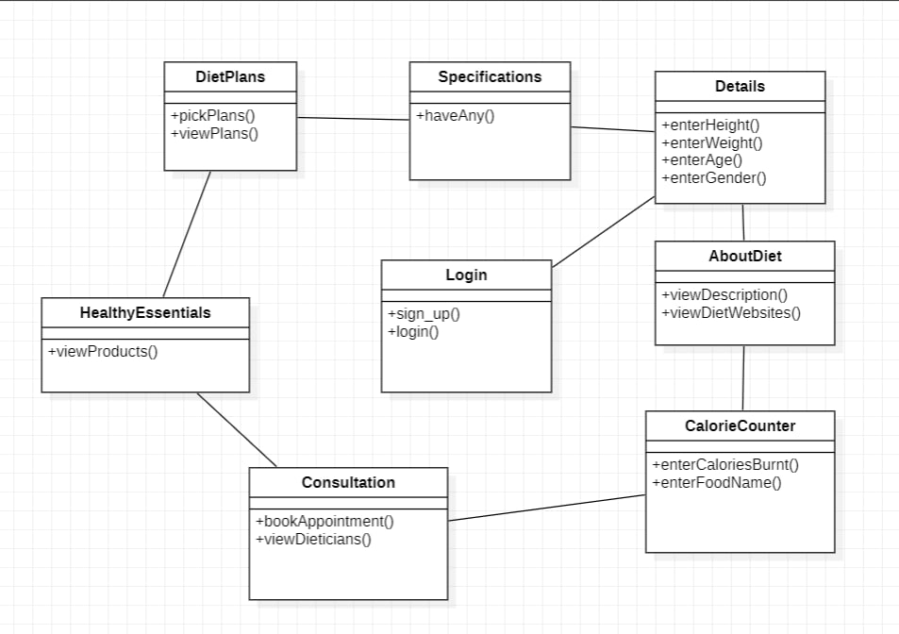
CLASS DIAGRAM

Slide 13
DATA STRUCTURES NEEDED
Tools:-
StarUML

Slide 14

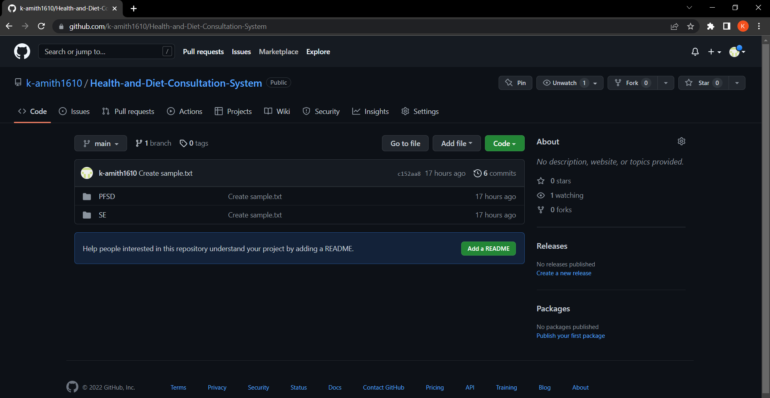
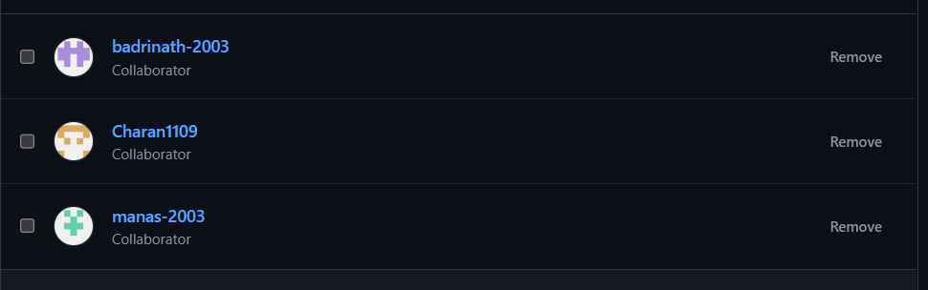
GITHUB SETUP
Link:- https://github.com/k-amith1610/Health-and-Diet-Consultation-System/tree/main/SE

Slide 15
DIVISION OF WORK AMONG THE GROUP MEMBERS
2110030085 – Work on Code implementation of Project.
2110030106 – Work on the Backend part of the Project as well as code implementation.
2110030163 – Work on the frontend part of the project.
2110030372 – Work on the frontend part as well as the backend part of the project.

Slide 16


